Slide 1
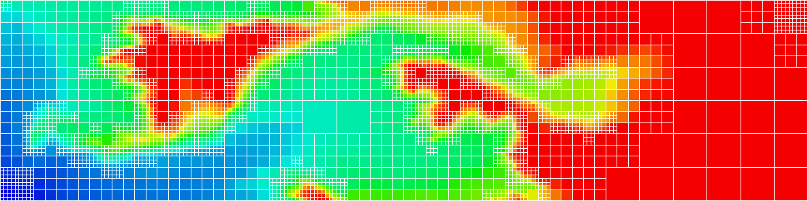
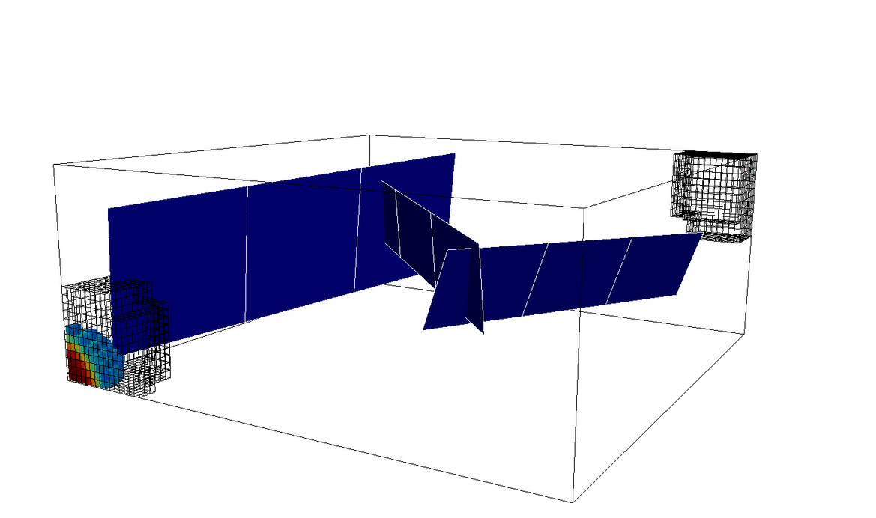
Algebraic Dynamic Multilevel method for Fractured porous media (F-ADM)
F-ADM
Mousa HosseiniMehr
Hadi Hajibeygi
Kees Vuik
TU Delft

Slide 2
Content
Introduction
Embedded Discrete Fracture Model (EDFM)
Multilevel Multiscale FVM for Fractured Porous Media
Algebraic Dynamic Multilevel Method for Fractured Porous Media (F-ADM)
Results
Conclusion
Content

Slide 3
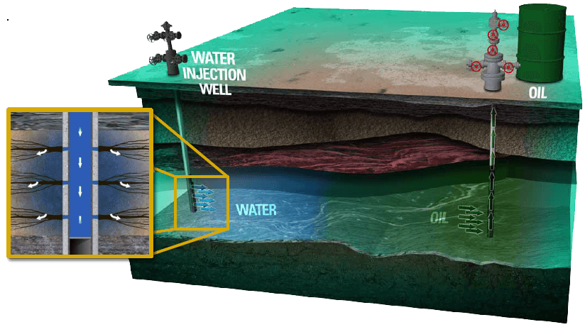
Introduction
Hydrocarbon Production
Introduction
EGS diagram (source: DOE, Geothermal Technologies Program)
Source: jogja-training.com

Slide 4
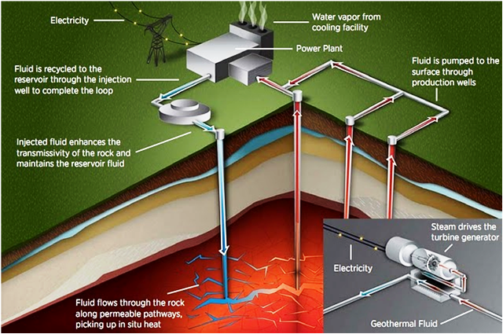
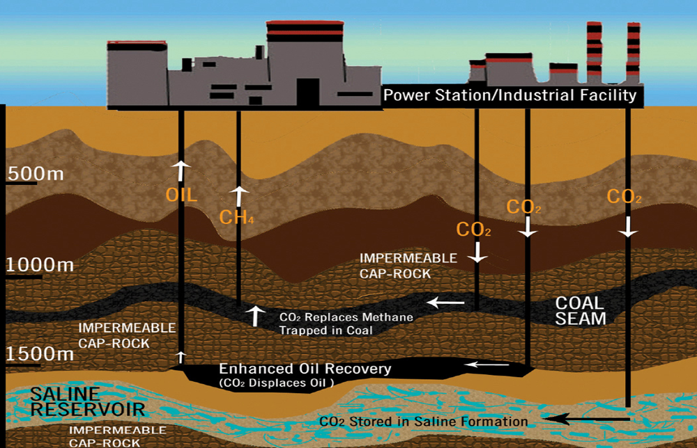
Introduction
Geothermal
Introduction
Carbon Capture and Storage
Enhanced Geothermal System (source: energyinformative.org)
Carbon Capture & Sequestration Flow Chart
(source: World Resources Institue)

Slide 5
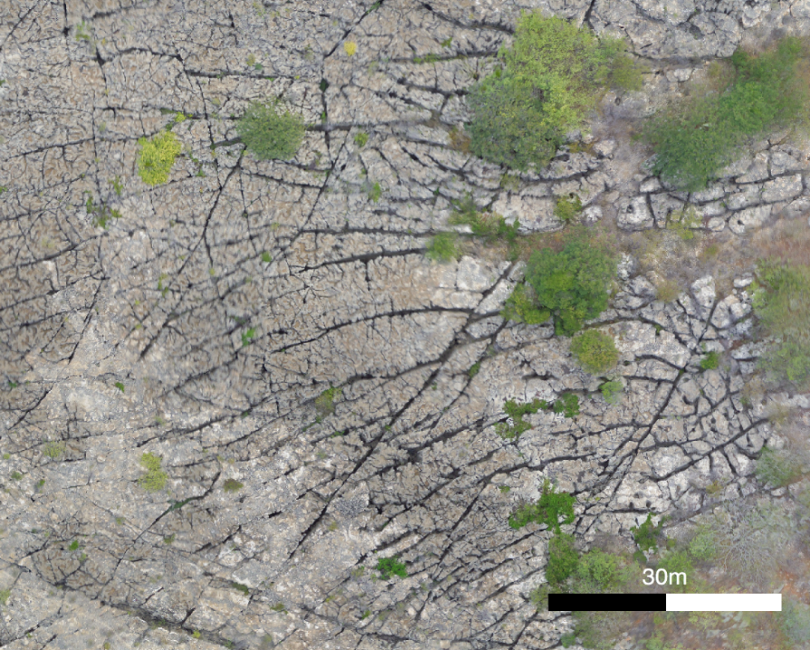
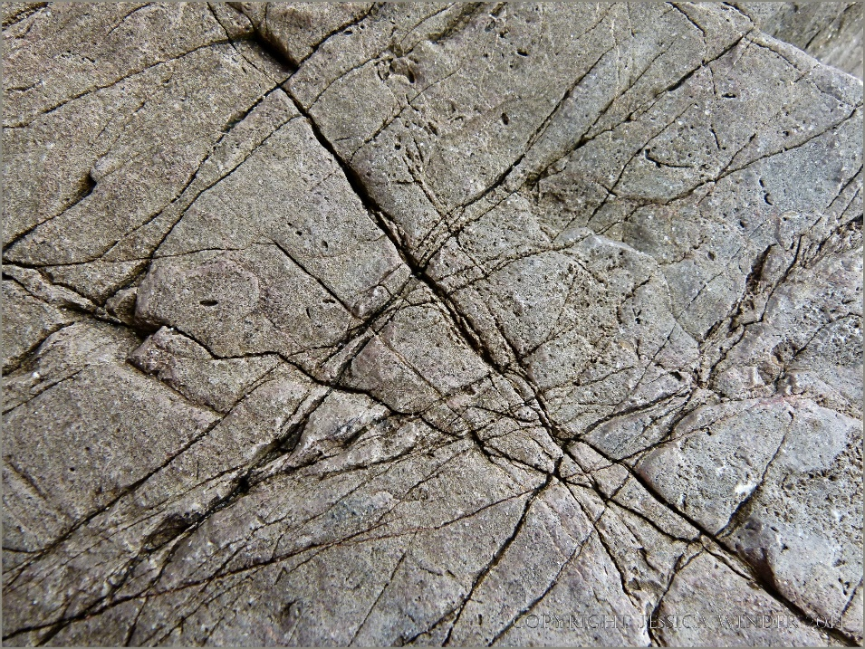
Introduction
Big Challenge: Fractures
Introduction
Potiguar Basin, Apodi, Brazil
(source: TU Delft Geoscience depart.)
Tenby Rock Textures, South Wales
(source: natureinfocus.blog)

Slide 6
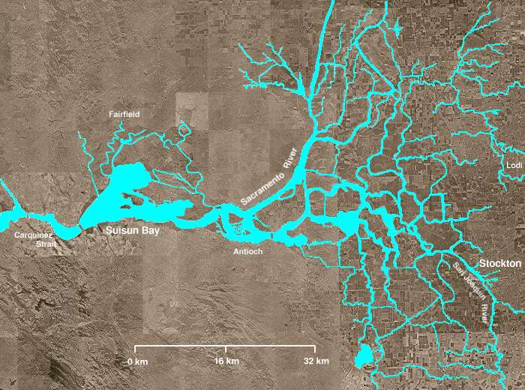
Introduction
Big Challenge: Fractures
Many reservoirs, naturally fractured
Complex interconnected networks
Divers geometrical properties
High conductivity contrasts
Heavy impact on fluid flow
High computational costs
Introduction
Sacramento-San Joaquin River Delta, California (source: Wikipedia)

Slide 7
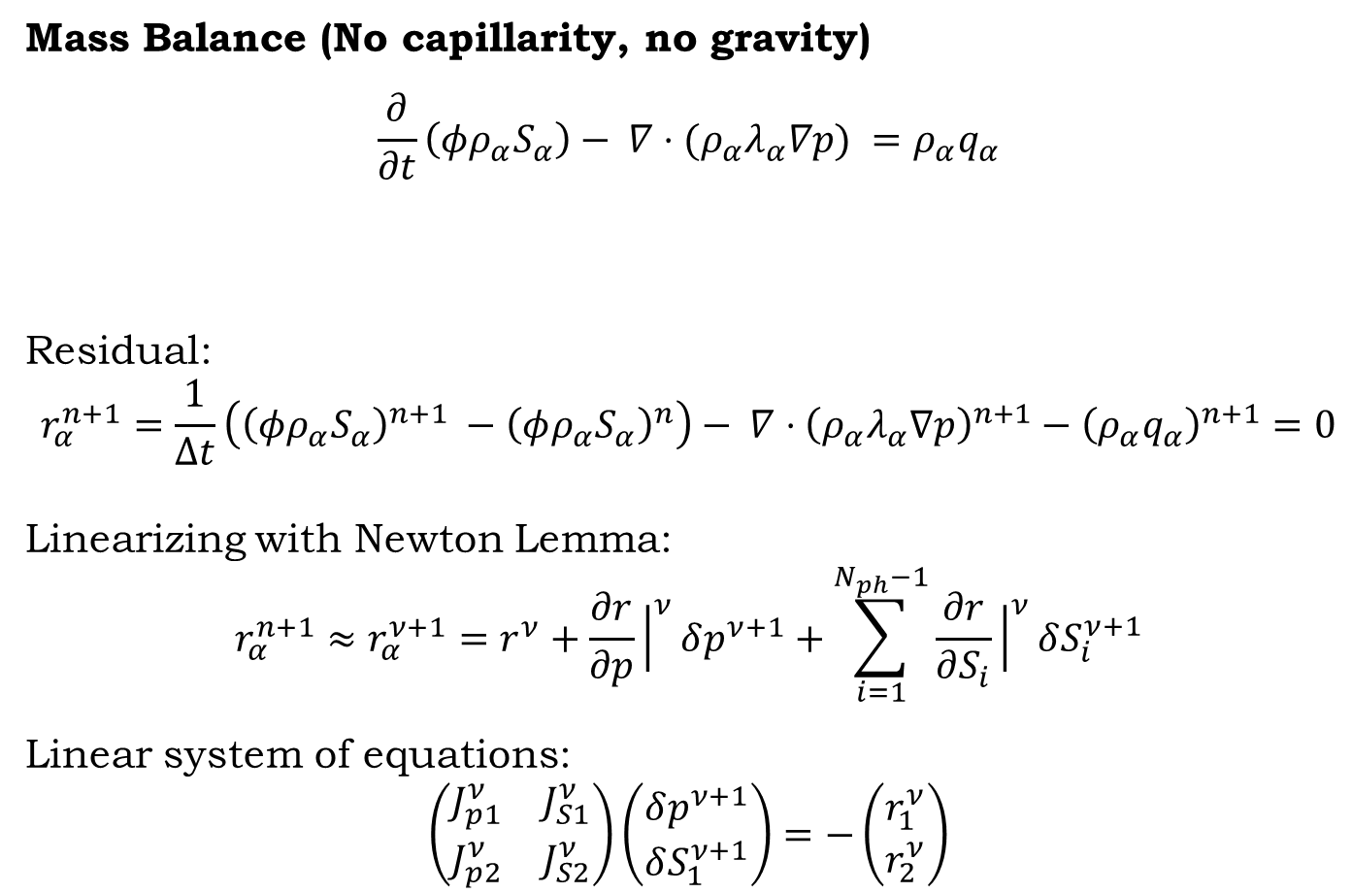
Introduction
Mass Balance (No capillarity, no gravity)
$$\frac{∂}{∂t}\left(φρ_{α}S_{α}\right)− ∇⋅(ρ_{α}λ_{α}∇p) =ρ_{α}q_{α}$$
Residual:
$$r_{α}^{n+1}=\frac{1}{Δt}\left({\left(φρ_{α}S_{α}\right)}^{n+1} −{\left(φρ_{α}S_{α}\right)}^{n}\right)− ∇⋅{\left(ρ_{α}λ_{α}∇p\right)}^{n+1}−{\left(ρ_{α}q_{α}\right)}^{n+1}=0$$
Linearizing with Newton Lemma:
$$r_{α}^{n+1}≈r_{α}^{ν+1}=r^{ν}+\frac{∂r}{∂p}{\left.​\right|}^{ν}δp^{ν+1}+\sum_{i=1}^{N_{ph}−1}{\frac{∂r}{∂S_{i}}{\left.​\right|}^{ν}δS_{i}^{ν+1}}$$
Linear system of equations:
$$\left(\begin{matrix}J_{p1}^{ν} & J_{S1}^{ν} \\ J_{p2}^{ν} & J_{S2}^{ν}\end{matrix}\right)\left(\begin{matrix}δp^{ν+1} \\ δS_{1}^{ν+1}\end{matrix}\right)=−\left(\begin{matrix}r_{1}^{ν} \\ r_{2}^{ν}\end{matrix}\right)$$
Introduction
Change of mass per volume in time
Net outflux
Source term

Slide 8
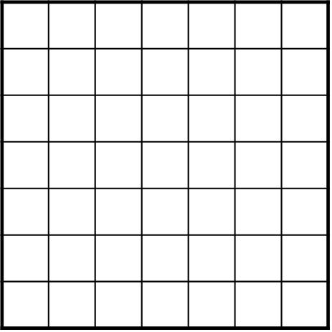
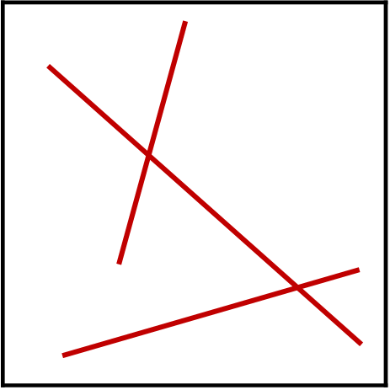
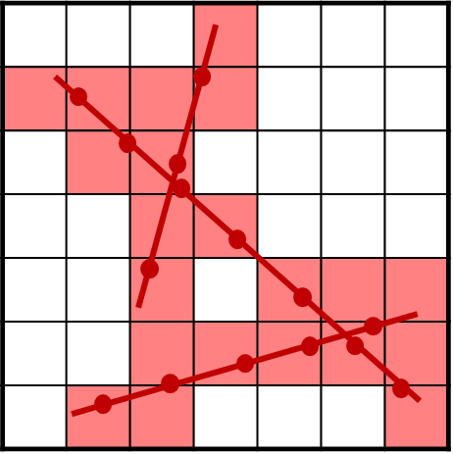


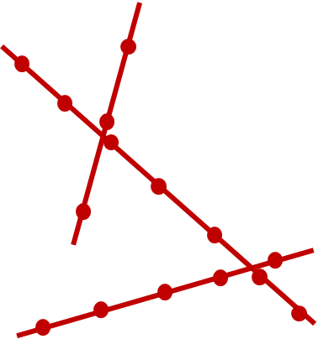
EDFM
Embedded Discrete Fracture Model (EDFM*)
Treating fractures as separate lower dimensional domains
Independent discretization of matrix and fractures
Simpler gridding structure
EDFM
* Lee et al., WRR 2001, Hajibeygi et al., JCP 2011

Slide 9
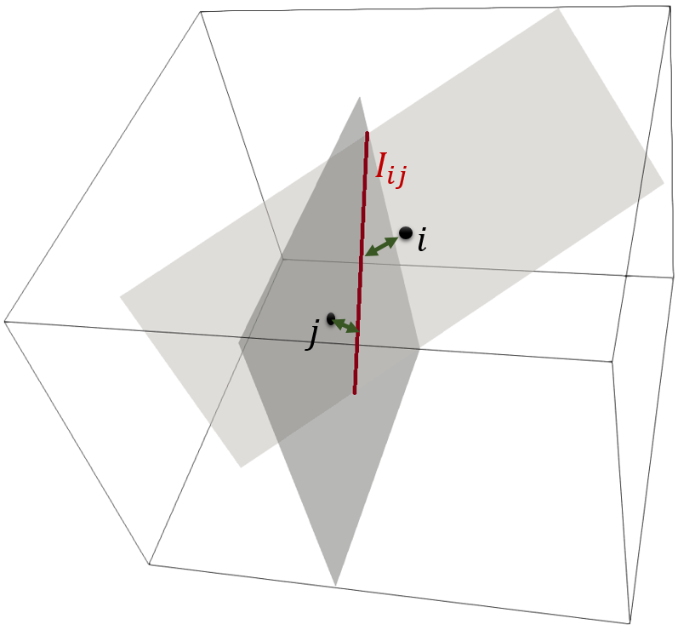
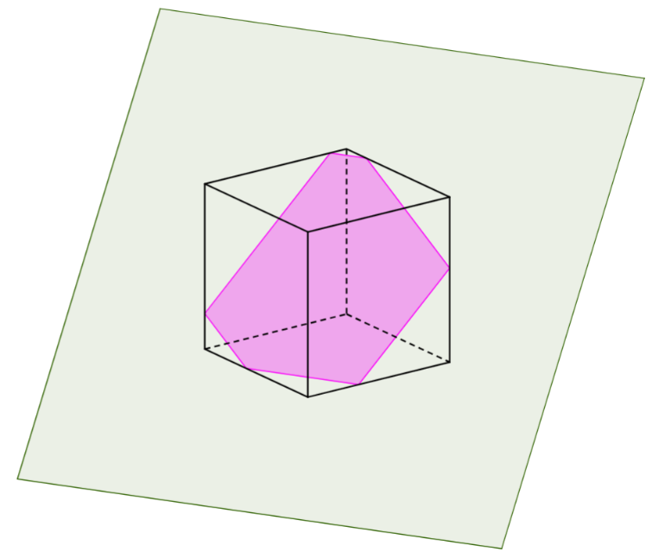
EDFM
Embedded Discrete Fracture Model (EDFM)
Treating fractures as separate lower dimensional domains
Independent discretization of matrix and fractures
Simpler gridding structure
EDFM

Slide 10
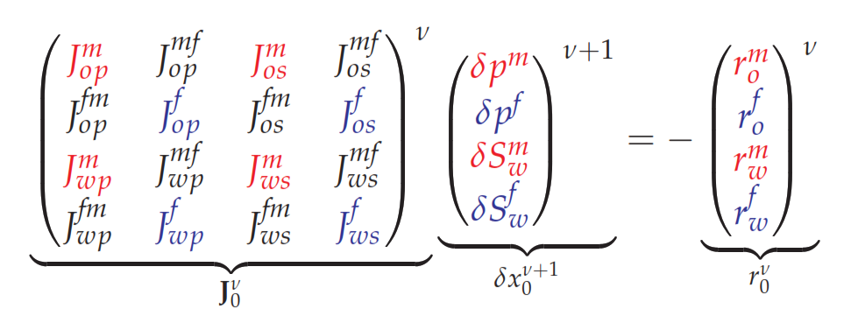
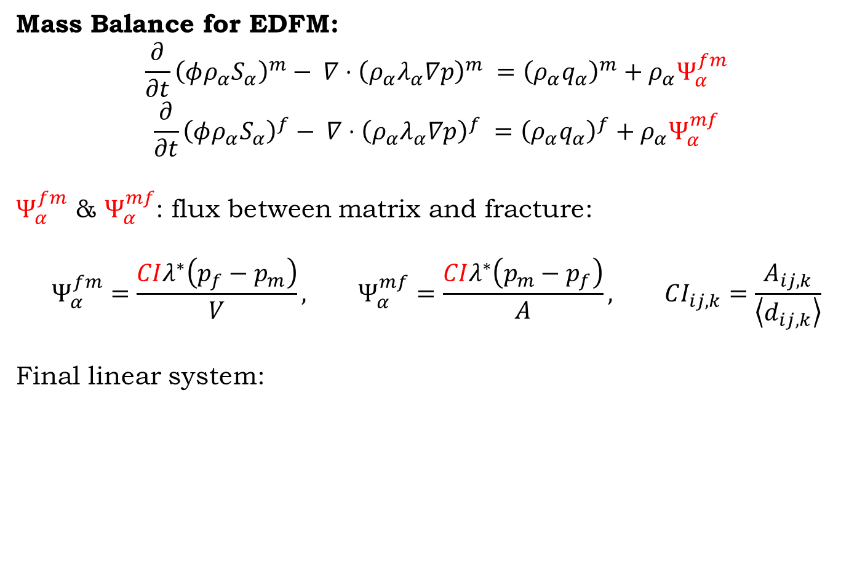
EDFM
Mass Balance for EDFM:
$$\frac{∂}{∂t}{\left(φρ_{α}S_{α}\right)}^{m}− ∇⋅{\left(ρ_{α}λ_{α}∇p\right)}^{m} ={\left(ρ_{α}q_{α}\right)}^{m}+ρ_{α}Ψ_{α}^{fm}$$
$$\frac{∂}{∂t}{\left(φρ_{α}S_{α}\right)}^{f}− ∇⋅{\left(ρ_{α}λ_{α}∇p\right)}^{f} ={\left(ρ_{α}q_{α}\right)}^{f}+ρ_{α}Ψ_{α}^{mf}$$
$Ψ_{α}^{fm}$ & $Ψ_{α}^{mf}$: flux between matrix and fracture:
$$Ψ_{α}^{fm}=\frac{CIλ^{∗}\left(p_{f}−p_{m}\right)}{V}, Ψ_{α}^{mf}=\frac{CIλ^{∗}\left(p_{m}−p_{f}\right)}{A}, CI_{ij,k}=\frac{A_{ij,k}}{\left\langle d_{ij,k}\right\rangle }$$
Final linear system:
matrix
EDFM
fracture

Slide 11
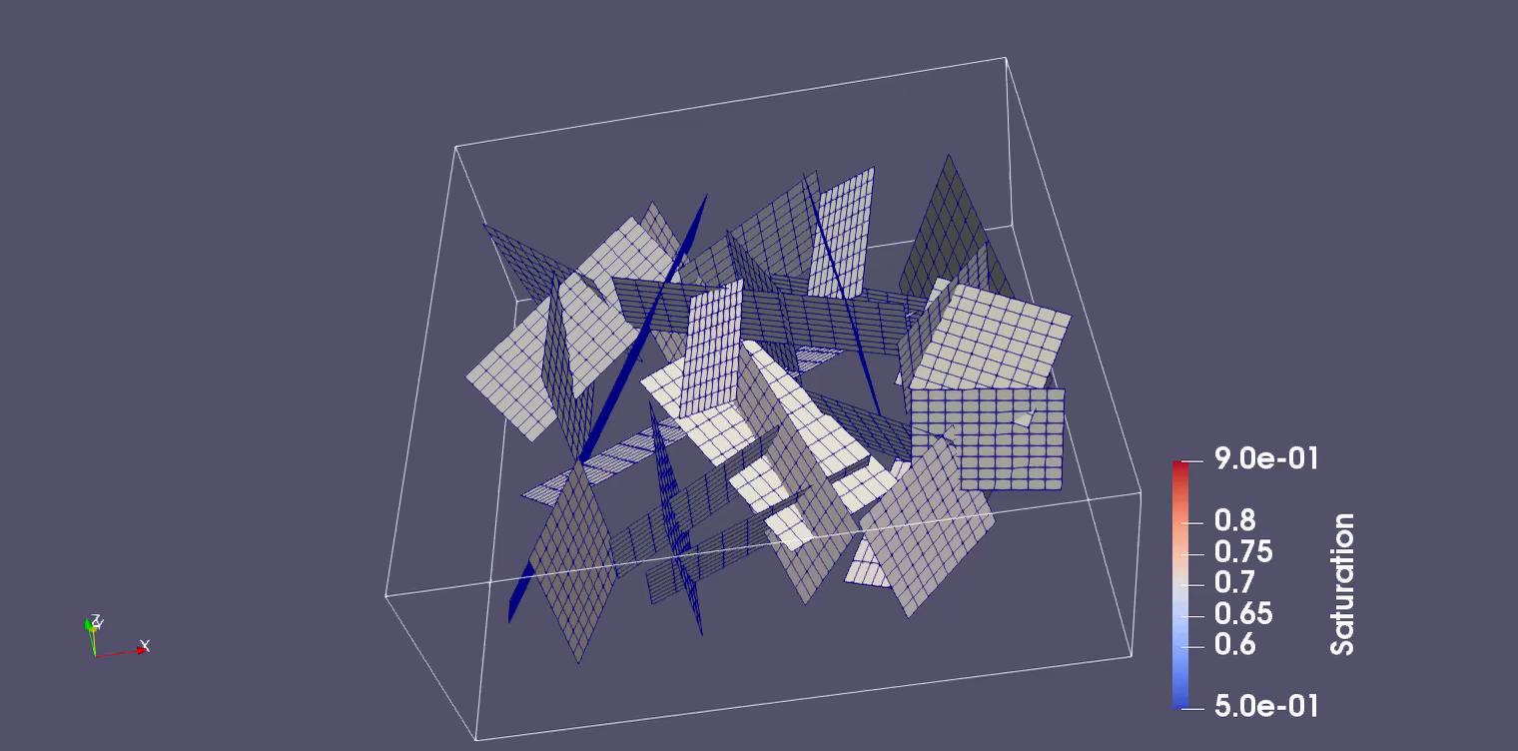
EDFM
EDFM

Slide 12
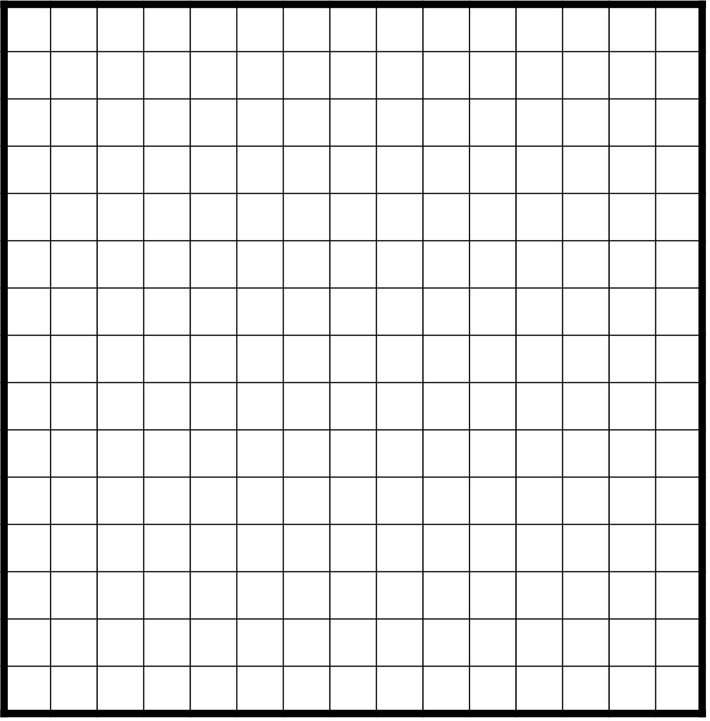
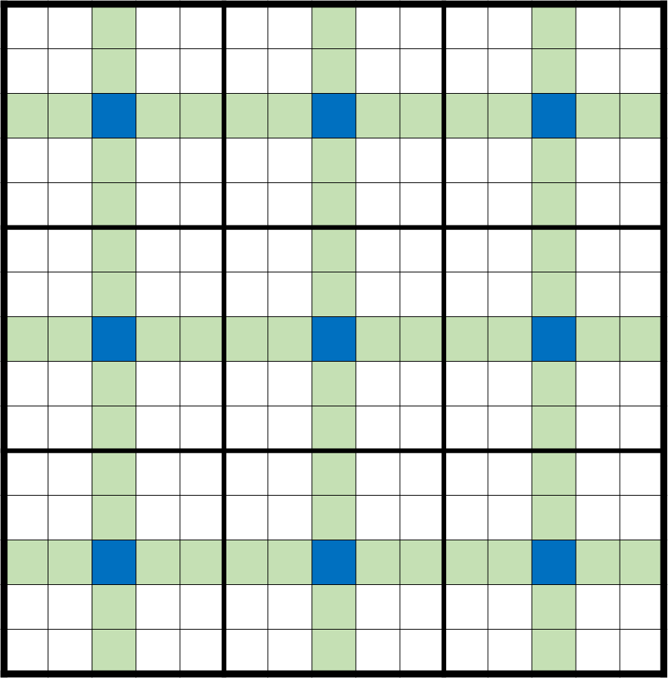
F-MMSFV
Multilevel Multiscale FVM for Fractures:
F-MMSFV
Dual coarse grid
Primal coarse grid

Slide 13
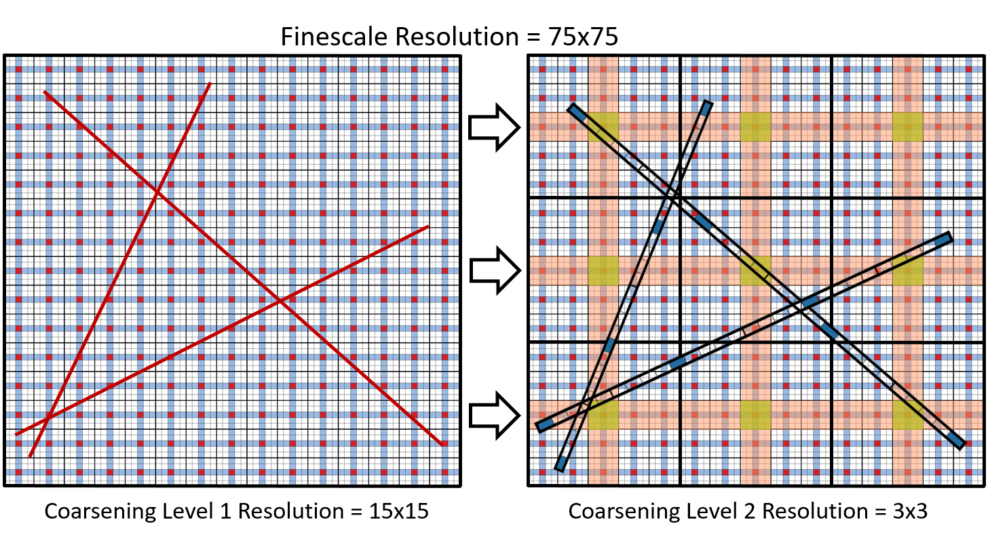
F-MMSFV
Multilevel Multiscale FVM for Fractures:
F-MMSFV

Slide 14
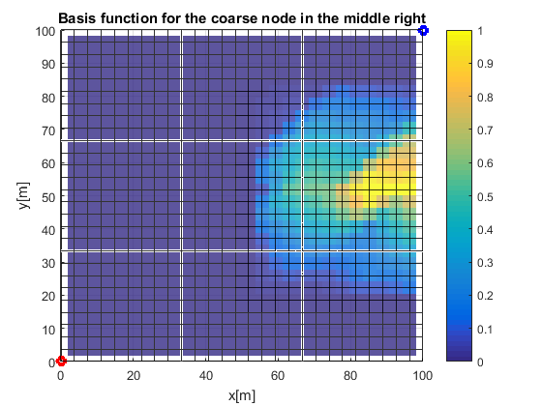
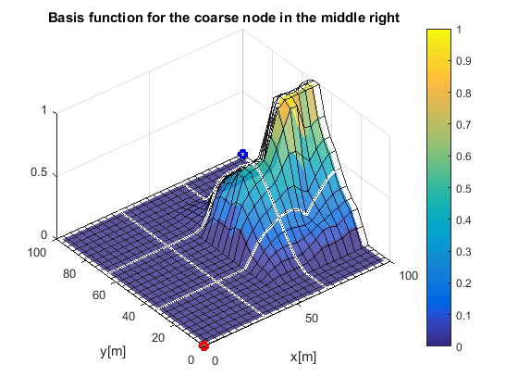
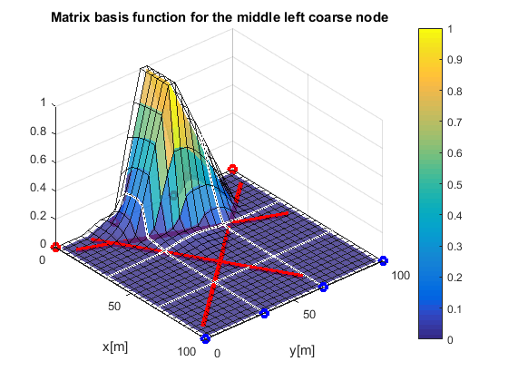
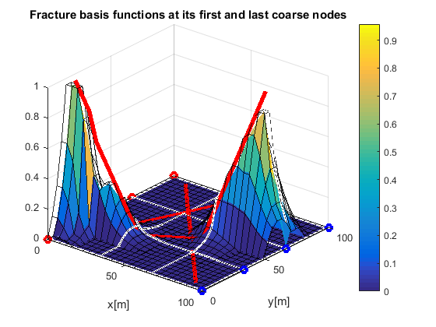
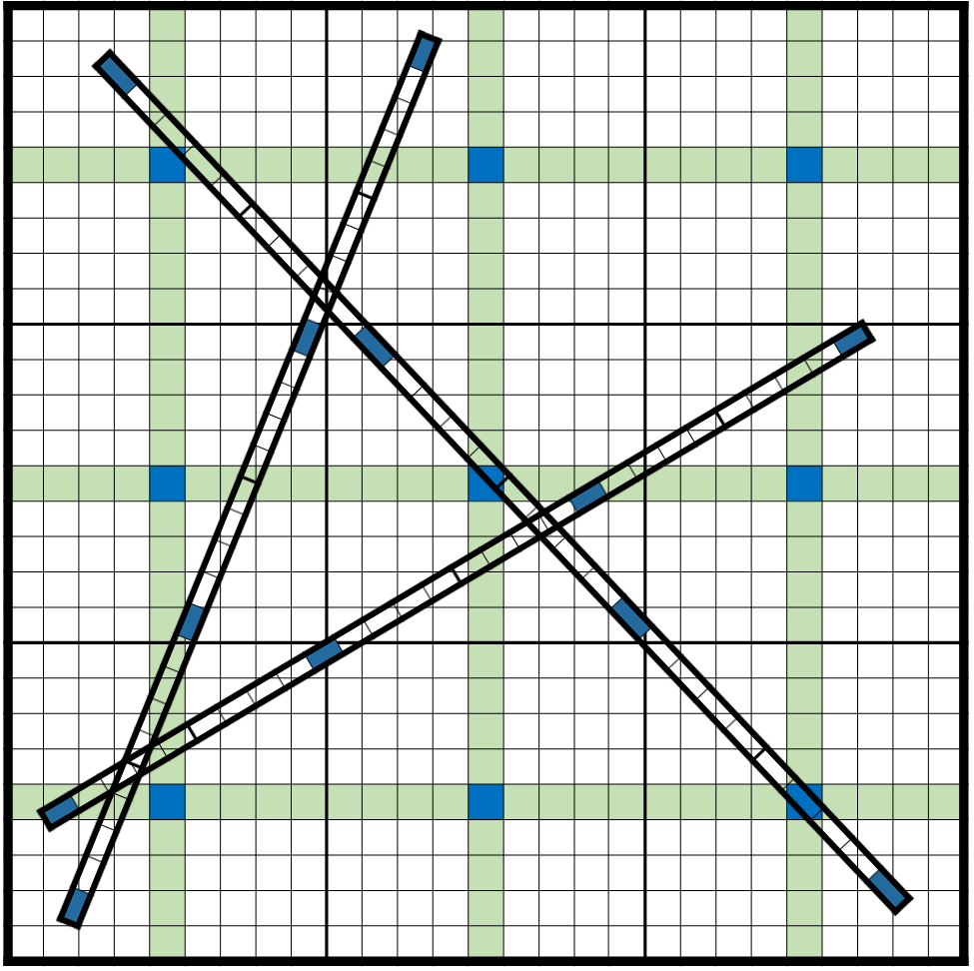
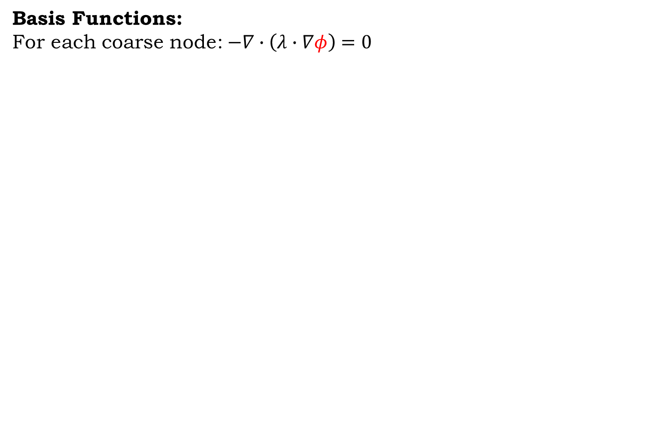
F-MMSFV
Basis Functions:
For each coarse node:$−∇∙\left(λ∙∇φ\right)=0$
F-MMSFV

Slide 15
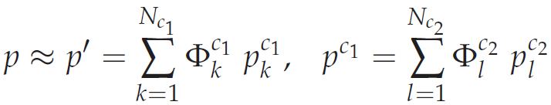
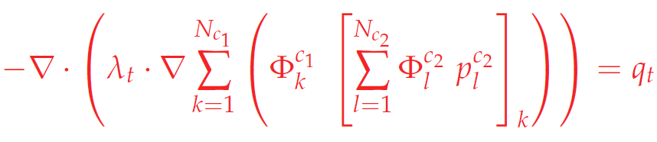
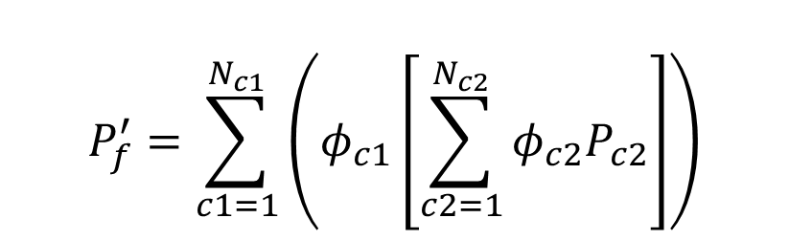
F-MMSFV
Solution for pressure:
Assuming 2 levels of multiscale:
F-MMSFV
$$P_{f}^{′}=\sum_{c1=1}^{N_{c1}}{\left(φ_{c1}\left[\sum_{c2=1}^{N_{c2}}{φ_{c2}P_{c2}}\right]\right)}$$
Unknown

Slide 16
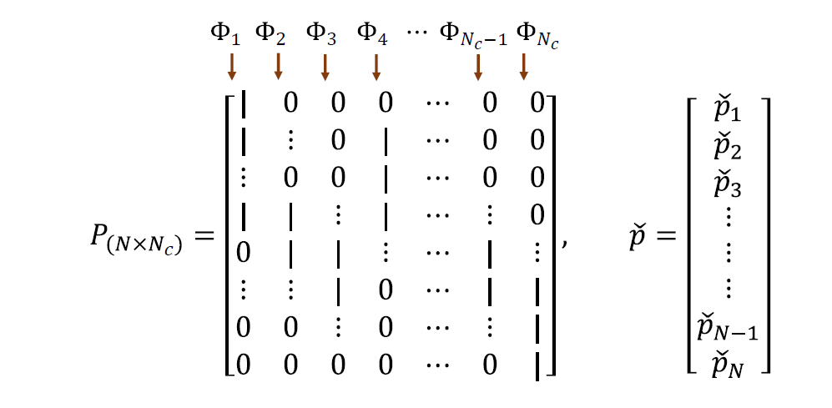
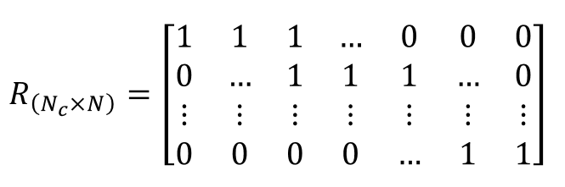
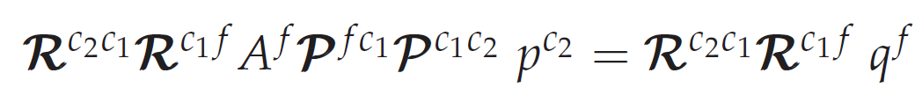
F-MMSFV
MMSV Operator:
Prolongation Operator
Mapping Coarse scale
to Fine scale
F-MMSFV
Restriction Operator
Mapping Fine scale
to Coarse scale

Slide 17
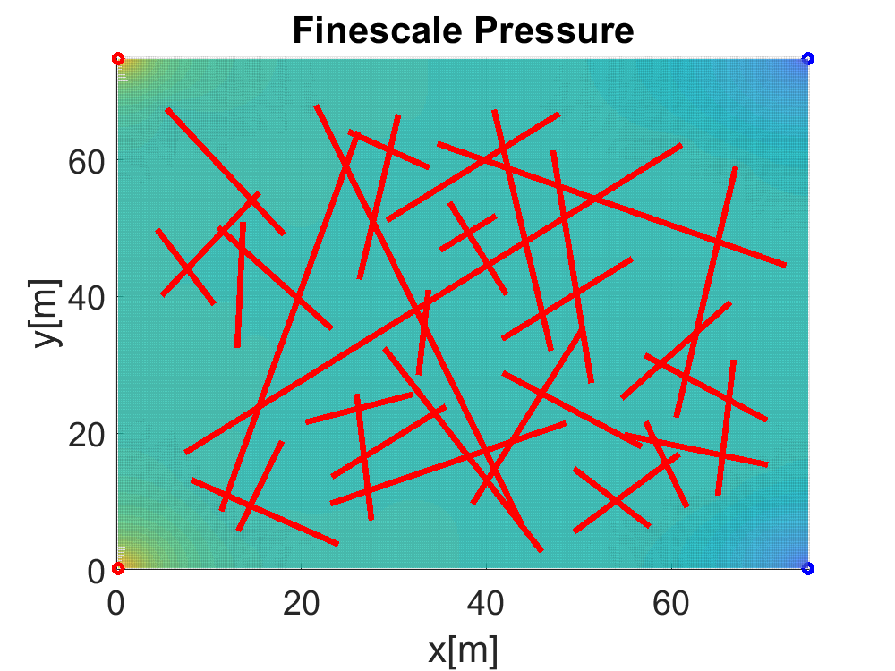
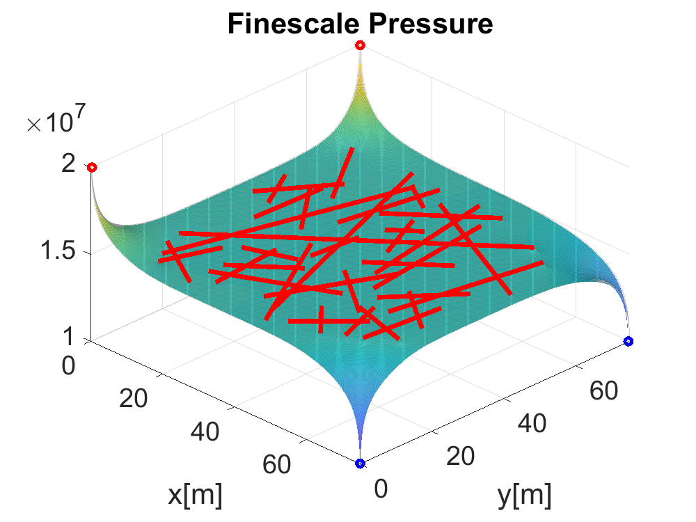
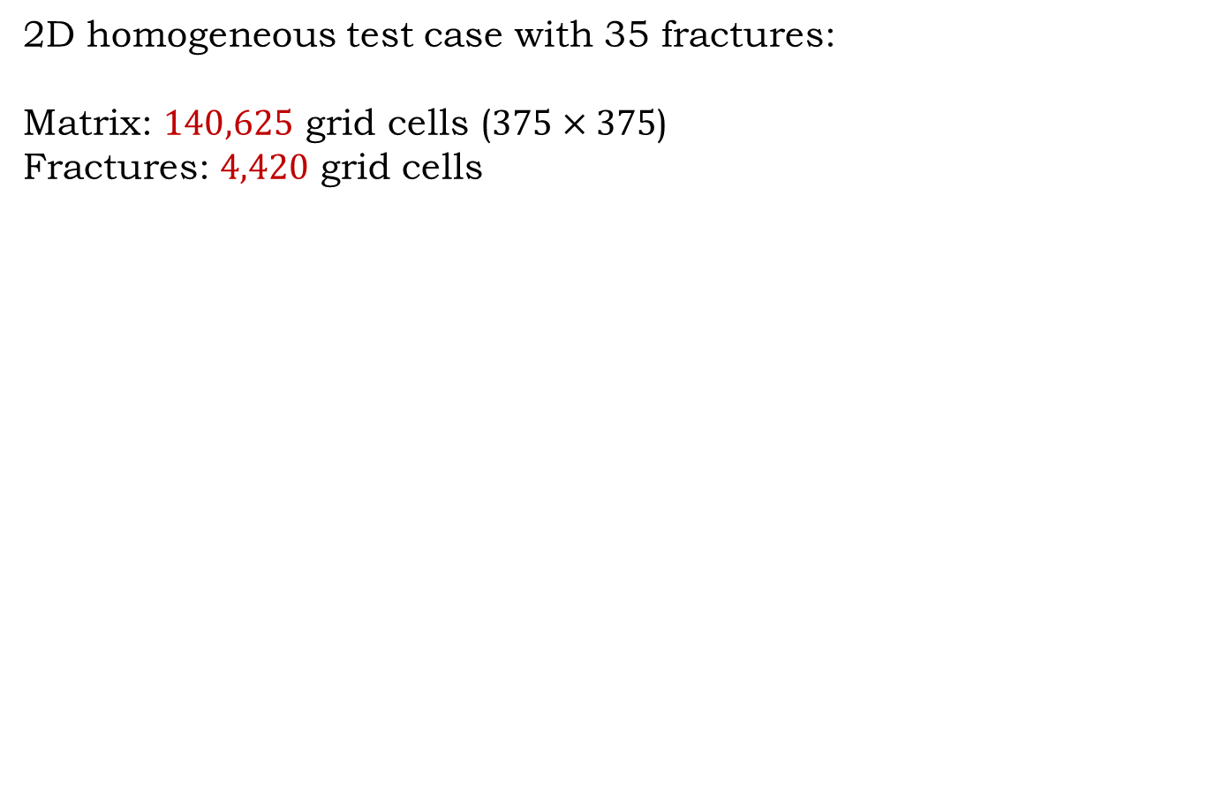
F-MMSFV
2D homogeneous test case with 35 fractures:
Matrix: $140,625$ grid cells ($375×375$)
Fractures: $4,420$ grid cells
F-MMSFV

Slide 18
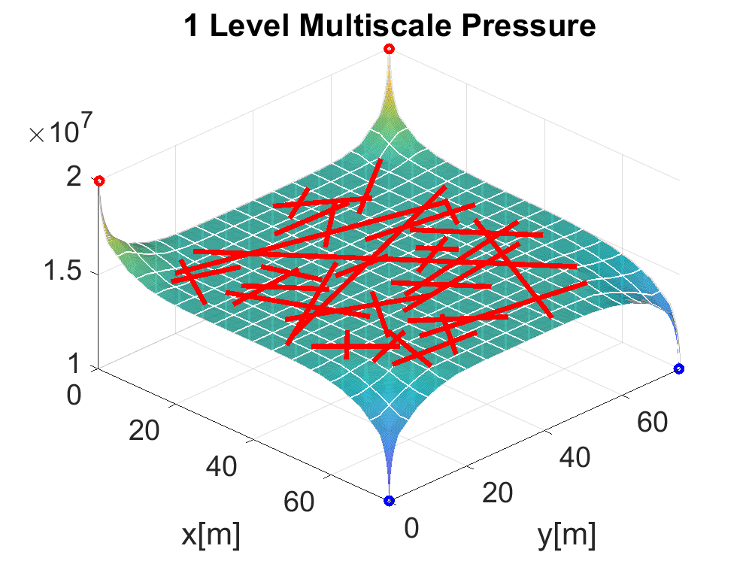
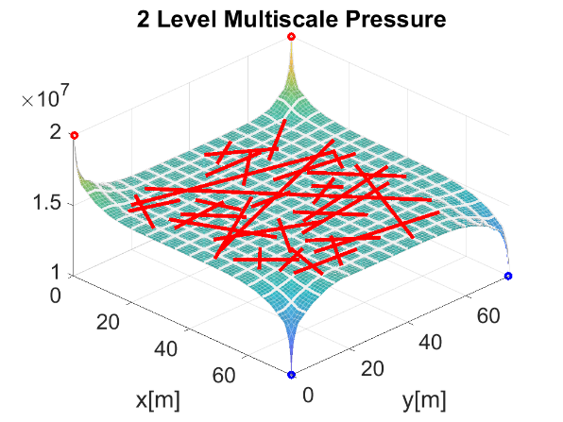
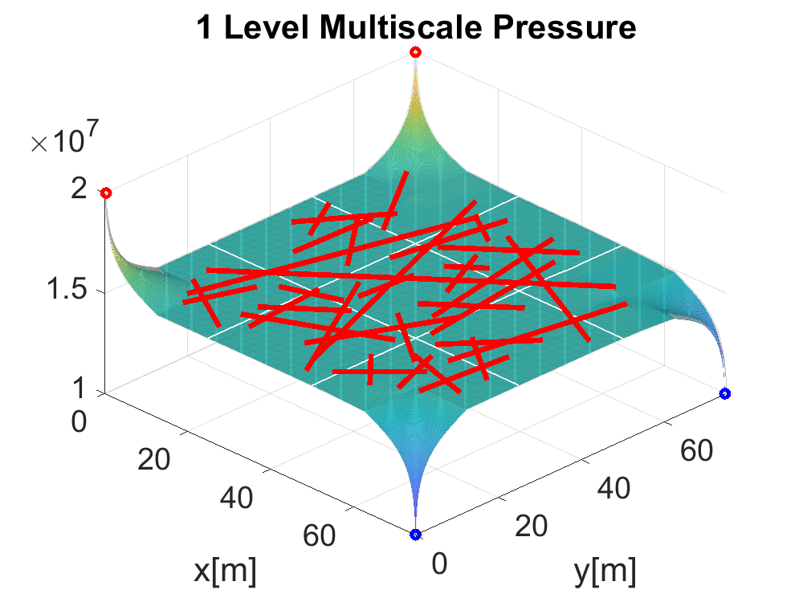
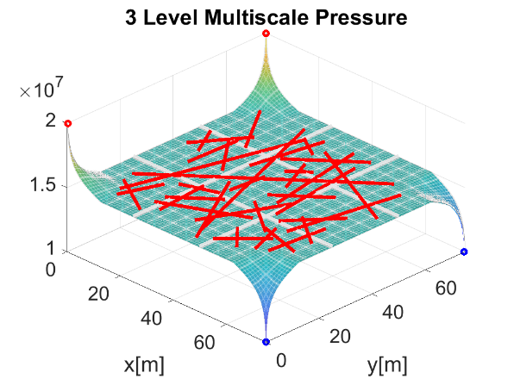
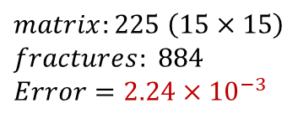
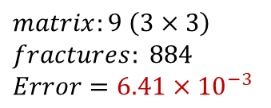
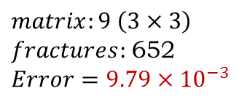
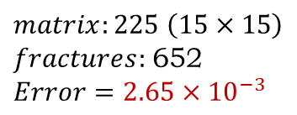
F-MMSFV
2D homogeneous test case with 35 fractures:
F-MMSFV
1 Level, Coarsening ratio 25
2 Levels, Coarsening ratio 5
$$matrix:225 \left(15×15\right)$$
$$fractures: 884$$
$$Error=2.24×{10}^{−3}$$
$$matrix:225 \left(15×15\right)$$
$fractures:$652
$$Error=2.65×{10}^{−3}$$
1 Level, Coarsening ratio 125
3 Levels, Coarsening ratio 5
$$matrix:9 \left(3×3\right)$$
$$fractures: 884$$
$$Error=6.41×{10}^{−3}$$
$$matrix:9 \left(3×3\right)$$
$fractures:$652
$$Error=9.79×{10}^{−3}$$

Slide 19
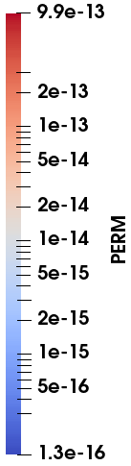
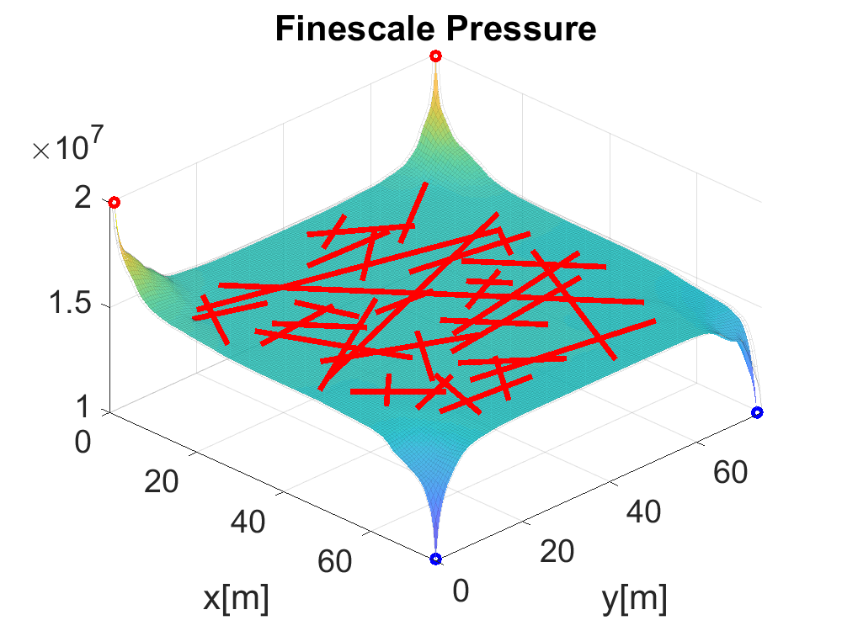

F-MMSFV
2D heterogeneous test case with 35 fractures:
Matrix: $18,225$ grid cells ($135×135$)
Fractures: $1,665$ grid cells
F-MMSFV

Slide 20
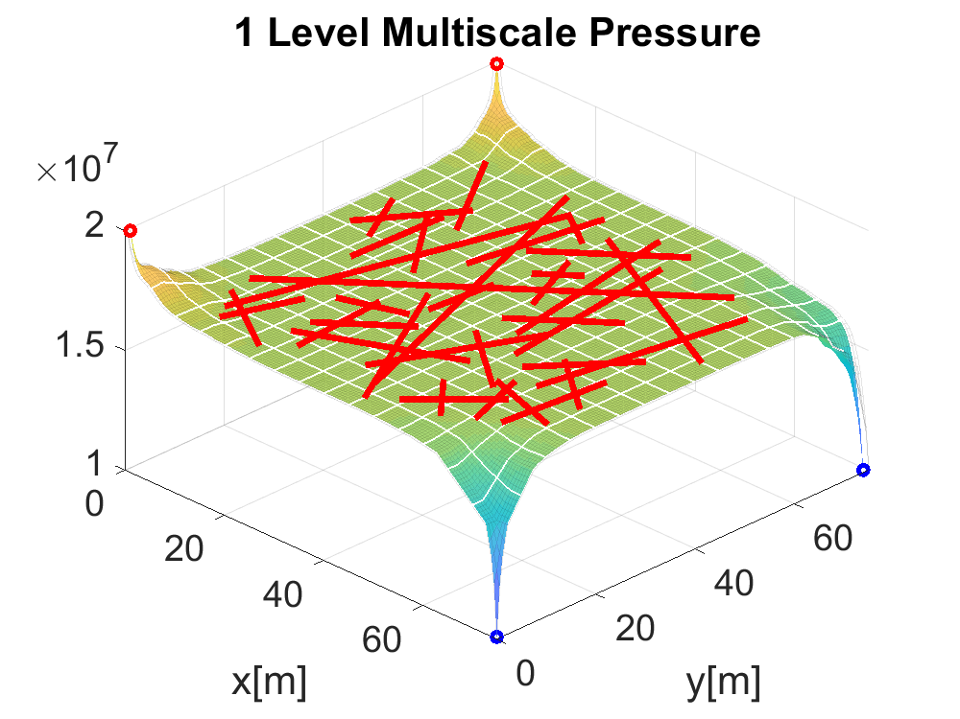
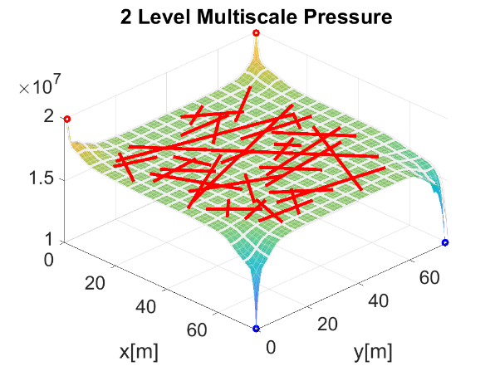
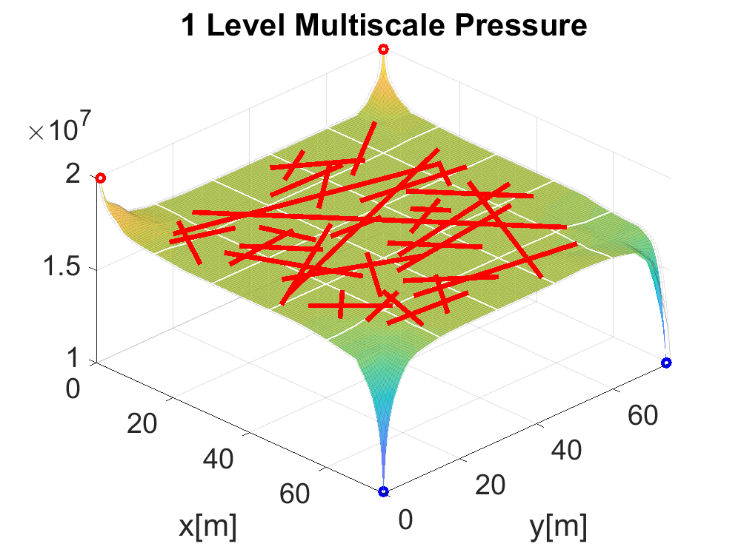
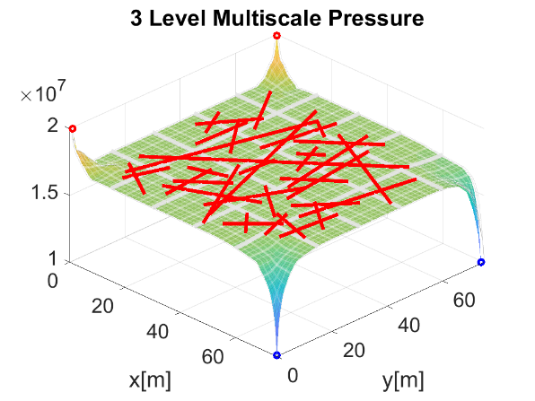




F-MMSFV
2D heterogeneous test case with 35 fractures:
F-MMSFV
1 Level, Coarsening ratio 9
2 Levels, Coarsening ratio 3
$$matrix:225 \left(15×15\right)$$
$$fractures:555$$
$$Error=1.27×{10}^{−1}$$
$$matrix:225 \left(15×15\right)$$
$fractures:$185
$$Error=1.36×{10}^{−1}$$
1 Level, Coarsening ratio 27
3 Levels, Coarsening ratio 3
$$matrix:25 \left(5×5\right)$$
$$fractures:555$$
$$Error=1.10×{10}^{−1}$$
$$matrix:25 \left(5×5\right)$$
$fractures:$185
$$Error=1.21×{10}^{−1}$$

Slide 21
F-ADM
Algebraic Dynamic Multilevel (ADM*) method for multiphase flow in Fractured porous media
P and S are fully coupled (Multiscale targets only P)
Resolution at the dynamic front is important for Saturation (transport)
Heterogeneity and fractures add complexity!
So we developed F-ADM!
F-ADM
* Cusini, van Kruijsdijk, Hajibeygi, JCP, 2016

Slide 22


F-ADM
Why F-ADM?
F-ADM
SPE10 Top Layer
* Cusini, van Kruijsdijk, Hajibeygi, JCP, 2016

Slide 23




F-ADM
It is algebraic:
ADM coarse:
Finescale approximation:
Prolongation operator:
Restriction operator:
F-ADM

Slide 24


F-ADM
It is dynamic:
Coarsening level is chosen by either:
Space derivatives
Time derivatives
Saturation front is captured at finer scale (tolerance based).
F-ADM

Slide 25
F-ADM
Advantages:
Higher efficiency (Reduction in number of active grid cells)
Accuracy (Keeping finer scale where it is needed)
Applicable to multiple phase flow
Independent matrix-fracture coarsening
F-ADM

Slide 26


F-ADM Results
Test Case 1:
3D Homogeneous matrix with 3 fractures
Matrix: $177,147$ grid cells ($81×81×27$), $K={10}^{−15}\left[m^{2}\right]=1 [mD]$
Fractures: $729$ grid cells (each $27×9$), $K={10}^{−5}\left[m^{2}\right]$
Coarsening ratio: 3
F-ADM Results

Slide 27
F-ADM Results
Test Case 1:
3D Homogeneous matrix with 3 fractures
Average amount of active cells: 25%
F-ADM Results

Slide 28



F-ADM Results
Test Case 2:
2D Heterogeneous matrix with 35 fractures
F-ADM Results
Matrix:
$75×75 [m^{2}]$
$18,225$ grid cells ($135×135$)
$K_{min}=1.3×{10}^{−16}\left[m^{2}\right]$
$K_{max}=9.9×{10}^{−13}\left[m^{2}\right]$
Coarsening ratio: 3
Fractures:
$1,665$ grid cells
$K={10}^{−5}\left[m^{2}\right]$
Aperture = $5×{10}^{−3}\left[m\right]=5[mm]$
Coarsening ratio: 3

Slide 29








F-ADM Results
Test Case 2:
2D Heterogeneous matrix with 35 fractures
F-ADM Results
$$ΔS=0.1$$
Active Cells$=56\%$
$$\left|\left|Error\right|\right|=4.3×{10}^{−2}$$
$$ΔS=0.3$$
Active Cells$=42\%$
$$\left|\left|Error\right|\right|=6.2×{10}^{−2}$$
$ΔS=0.$5
Active Cells$=30\%$
$$\left|\left|Error\right|\right|=9.5×{10}^{−2}$$
$$ΔS=0.8$$
Active Cells$=14\%$
$$\left|\left|Error\right|\right|=1.9×{10}^{−1}$$

Slide 30




F-ADM Results
Test Case 2:
2D Heterogeneous matrix with 35 fractures
F-ADM Results

Slide 31



F-ADM Results
Test Case 3:
3D Homogeneous matrix with 26 fractures
F-ADM Results
Matrix:
$75×75×30 [m^{3}]$
$264,627$ grid cells ($99×99×27$)
$K={10}^{−15}\left[m^{2}\right]=1 [mD]$
Coarsening ratio: 3
Fractures:
$2,646$ grid cells
$K={10}^{−5}\left[m^{2}\right]$
Aperture = $5×{10}^{−3}\left[m\right]=5[mm]$
Coarsening ratio: 3

Slide 32
F-ADM Results
Test Case 3:
3D Homogeneous matrix with 26 fractures
F-ADM Results

Slide 33




F-ADM Results
Test Case 3:
3D Homogeneous matrix with 26 fractures
F-ADM Results

Slide 34
F-ADM
Conclusion:
Subsurface porous media is heterogeneous and fractured
Fractures play a significant role in fluid transport
We need special methods like EDFM to avoid excessive fine scale resolutions
Multilevel multiscale provides acceptable approximate solution by reducing the number of DOFs
F-ADM provides an acceptable efficiency while honoring accuracy by applying necessary resolution as it is needed.
Conclusion

Slide 35
F-ADM
Next Steps:
Systematic study of F-ADM
Extension to geothermal formulation
Extension to geomechanics (elastic deformation)
Next Steps

Slide 36
THE END
Thank You
Thank You For Your Attention
Questions?

